Slide 1
Home Sweet Home
Requirements Report.
Jonathan Dowe & Sandro Britto

Slide 2
About Home Sweet Home
Alison recently inherited her father’s real estate agency, Home Sweet Home(HSH) after he passed in a car accident. She has decided to expand the business to the next-door premise with the $75,000 She received from her father’s will. The business has no outstanding debt. Through the business plan Alison decided to get a bank loan $125,000. The business plan also notes that there is a dire need to update their information systems, thus they have contacted us to build their new information system.

Slide 3
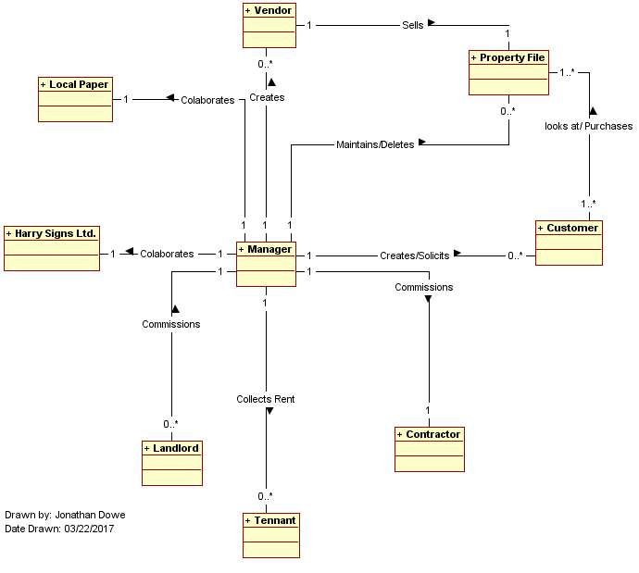
Home sweet Home Class diagram

Slide 4
Class: Contractor
Responsibilities | Operations | Collaborators
Doing monthly Maintenance for HSH Charging HSH for maintenance fees | Maintain Property | Manager

Slide 5
About Manager
The Manager Represents all members of the HSH staff that will be using to system. The Manager will be creating and updating all the fields in the information system that are not set to automatically do so. The manager will be involved in all Operations that the HSH system will provide.
The manager also Collects the revenue generated by various business operations to put in the HSH account file

Slide 6
Manager Card
Class: Manager
Responsibilities | Operations | Collaborators
Creates Properties Creates Customers Creates Vendors Checks Properties Creates Empty Appointments Creates Vendor Appointments Creates Offers Updates Offers Deletes Properties Creates Mail Listings Collects Rent Pays Maintenance fees Charges Commission Collects Sale Fees Gives Deduction payment | Create Property Advertisement Mail Listings Vendor Withdraw Vendor Appointment Empty Appointment Property Check Offer Offer Withdraw Sold Letting Maintain Property | Vendor Customer Local Paper Harry Signs Ltd. Landlord Tenant Contractor

Slide 7
About vendor
A Vendor will call when they want to sell a house, a representative at HSH will gather the property details to be used later in the creating the property file. A picture of the property is also collect so they can better advertise it in the office. Harry Signs Ltd a collaborator of HSH will be contacted to put up a sign on the property. The property is then advertised through the local news paper A
vendor can also decide that they no longer want to sell their property, in that chase the property will be able to request HSH to withdraw their property. HSH will delete the property after collecting a fee for services of listing property. A memo is added on to the vendor’s file noting the withdraw and the reason for it.

Slide 8
Vendor Card
Class: Vendor
Responsibilities | Operations | Collaborators
Request Property Sale Withdraw Property Sale Accepts Appointments Accepts Offers | Create Sale Vendor Withdraw Vendor Appointment Offer Sold | Manager Customer

Slide 9
About Customer
A Customer will contact HSH to ask for an appointment on current properties, make an offer for a current property, withdraw an offer for a current property, and buy the property. When a customer comes to make an appointment for either a property that has a vendor or one that does not, their information is collect and stored in a Customer file in the Customer Records. For appointments that need a vendor, an HSH representative will check the Vendor file associated with the property file for the times they have listed as being available to give tours of the property. For empty properties the Customer will suggest a time within HSH business hours and an HSH representative will give the tour of the property

Slide 10
Customer card
Class: Customer
Responsibilities | Operations | Collaborators
Call for vendor Appointments Call for Empty appointments Call to Make offer Call to withdraw offer Buy property Receive Mail listings | Vendor Appointment Empty Appointment Offer Offer Withdraw Mail Listings | Manager Vendor

Slide 11
About property File
The Property File Contain all the properties that HSH manages for Vendors as well as properties that do not have a vendor for various reasons, such a foreclosure, death, etc.

Slide 12
Property Card
Class: Property File
Responsibilities | Operations | Collaborators
Keep Track of all properties that are currently in the HSH system | Mail listing Advertisement Property check Offer Offer Withdraw Create Property Vendor Withdraw Sold | Manager Vendor Customer

Slide 13
About harry signs ltd
Harry Signs Ltd is a trusted Partner of HSH. They will put up a sign for properties that are being sold by HSH as soon as they are informed of the sale. They also updated the for sale signs to reflect when an offer has been placed with a sale Pending sign and updating it back to a for sale sign if the offer is withdrawn. They will also update the property with a sold sign when notified. These signs allow for people who may be local to the area who may be in need of a house for various reasons to see that there is one for sale, thus creating a potential sale

Slide 14
Harry Signs Ltd Card
Class: Harry Signs Ltd.
Responsibilities | Operations | Collaborators
Put up for sale signs on properties Update for sale signs to sale pending signs Change sale pending signs to for sale signs upon offer withdraw Take down pending signs on sold property | Create Sale Offer Offer Withdraw Sold | Manager

Slide 15
About local paper
The local Paper is a good source of tapping into potential customers. HSH will send a list of Featured properties to put in the papers ad s

Slide 16
Local Paper Card
Class: Local Paper
Responsibilities | Operations | Collaborators
Receive property ads from Manager Class Post Property ads in Paper | Advertisement | Manager

Slide 17
About tenant
The tenant of the landlord has little to no interaction with the system. The only thing the tenant does is pay rent

Slide 18
Tenant Card
Class: Tenant
Responsibilities | Operations | Collaborators
Pay Rent to HSH Manager | Letting | Manager Landlord

Slide 19
About landlord
The landlords likes to collect his rent through HSH for various reasons such as, being disabled, distance from rental properties, etc. and thus HSH is able to receive a rent.
The landlord also will commission HSH to get their contractor to preform maintenance of the rental properties because of how great a deal HSH has with this contractor.

Slide 20
Landlord Card
Class: Landlord
Responsibilities | Operations | Collaborators
Receive remaining rent from HSH Pay HSH for maintenance fees | Letting Maintain Property | Manager Tenant

Slide 21
About contractor
The contractor collaborate with HSH and because of this, HSH is able to get great deals on the contractors maintenance services

Slide 22
Contractor card
Class: Contractor
Responsibilities | Operations | Collaborators
Doing monthly Maintenance for HSH Charging HSH for maintenance fees | Maintain Property | Manager

Slide 23
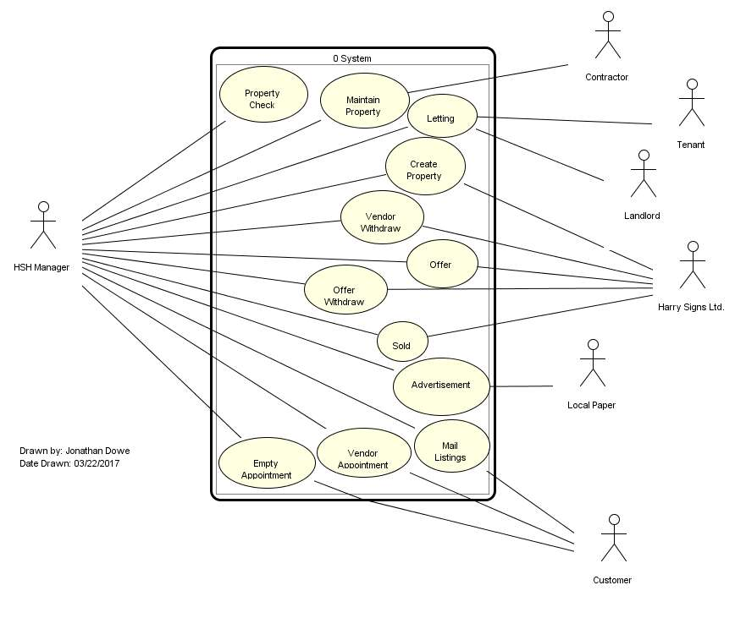
Home sweet home use case diagram

Slide 24
Use case Diagram brief summary
Vendors will be able to request to sell their properties though HSH as well as withdraw those offers. The Customers that HSH deals with will be able to get appointments with properties that currently have no offers on them. They can also place and withdraw offer as well as purchase the property. Customers can also sing up to a milling list to get emails about the featured properties for the month.
HSH has many collaborates, some that help them draw in sales, and others that they help. Collaborators that help HSH draw in potential customs is Harry Signs Ltd. A company that specializes in putting up for sale signs on properties and keeping the sign up to date with the properties offer pending and sold status’. HSH will also Feature properties n the Local paper.

Slide 25
Create Property Overview
A vendor calls wanting to sell a property they own. HSH then collects their information and records into a vendor file. The file is the saved into the vendor records. After the vendor’s information is recorded into the vendor records the HSH representative gathers the property details, these details are then put into a property file in the property records

Slide 26
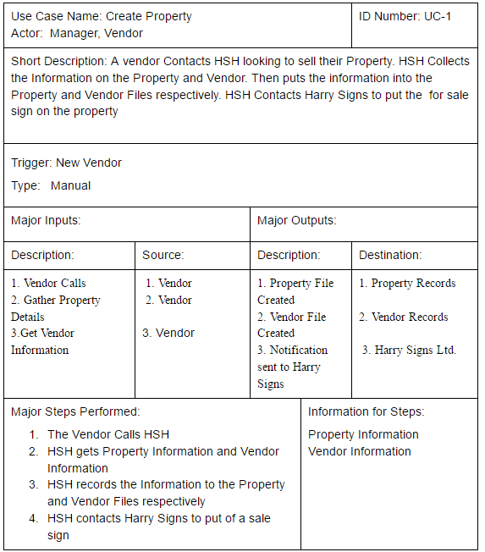
Create Property Case

Slide 27
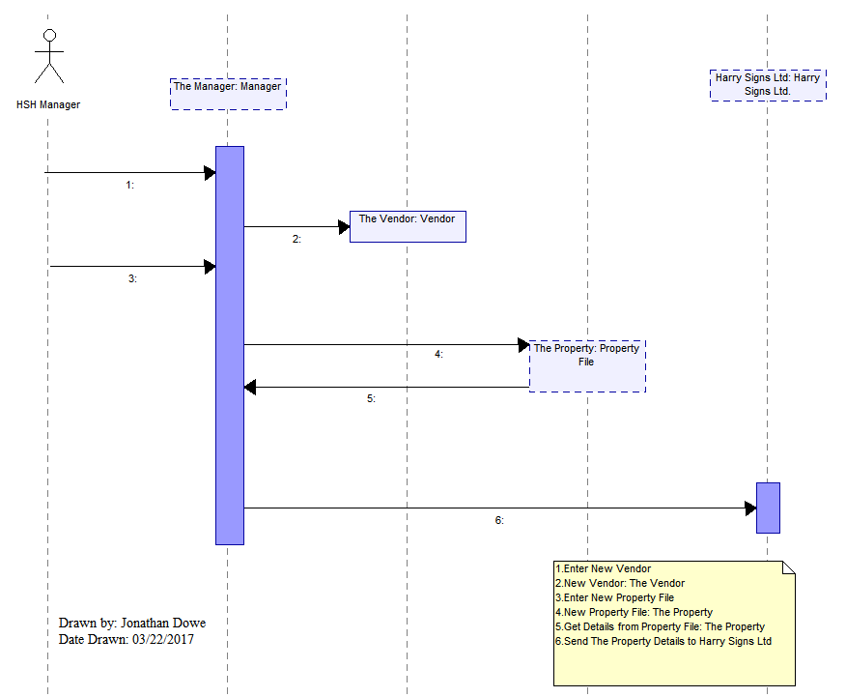
Create Property Sequence Diagram

Slide 28
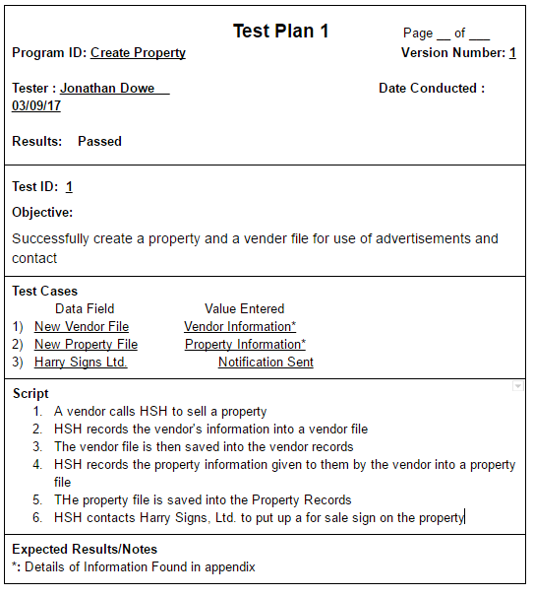
Create Property Test plan

Slide 29
Vendor Withdraw overview
A vendor that has contacted HSH before gets in touch with HSH again to inform HSH that they no longer want to sell their property. HSH then collets a fee for the services utilized in the property creation. The Property file is then deleted for the property records

Slide 30
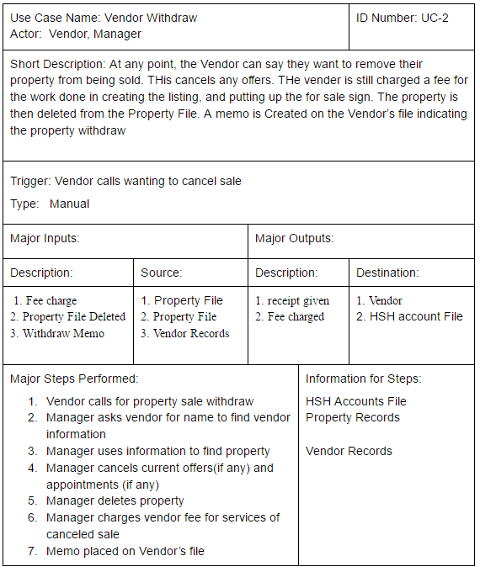
Vendor withdraw case

Slide 31
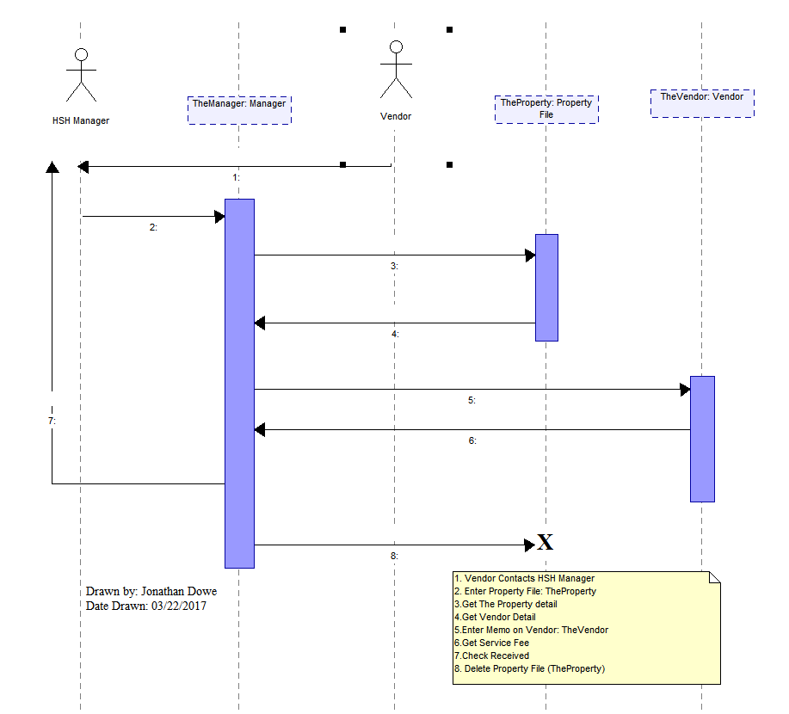
Vendor withdraw sequence diagram

Slide 32
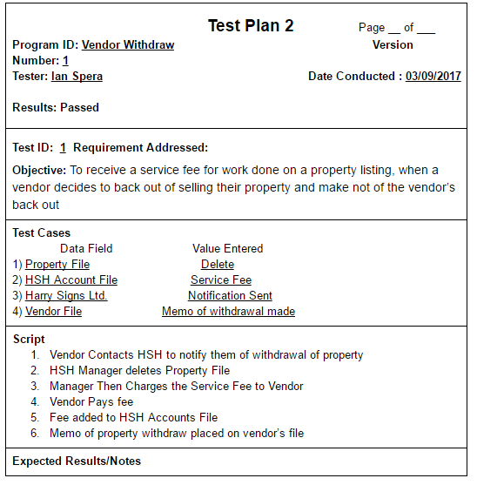
Vendor withdraw test plan

Slide 33
Vendor appointment overview
A customer Calls wanting an appointment with a property that has a vendor.
HSH the gives the customer the availability for appointments for a tour of the property. The Customer then chooses a time and an notification is sent to the vendor

Slide 34
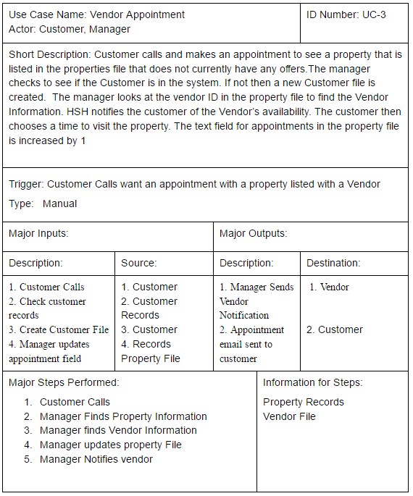
Vendor appointment case

Slide 35
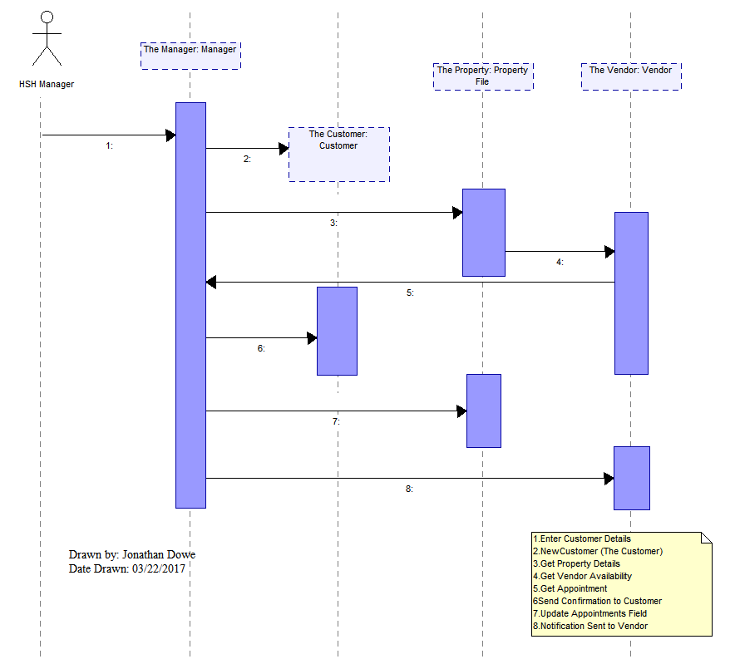
Vendor appointment sequence diagram

Slide 36
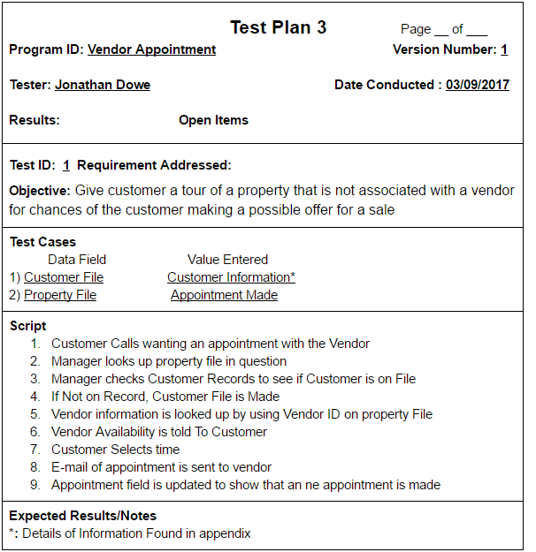
Vendor appointment test plan

Slide 37
Empty appointment overview
A customer calls wanting an appointment with a property that does not have a vendor selling it. HSH then gets the customer’s availability during the business hours of HSH so a representative will be able to give them a tour of the property

Slide 38
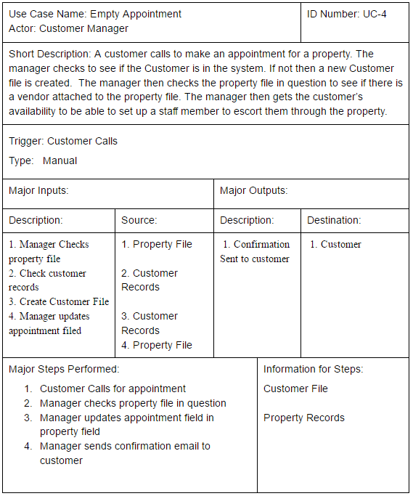
Empty appointment case

Slide 39
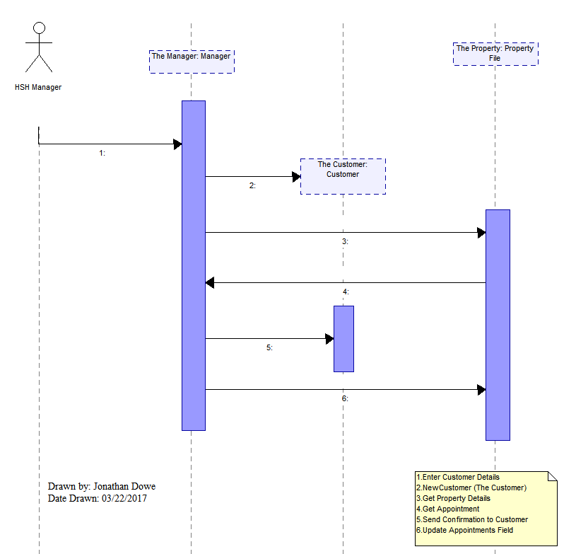
Empty appointment sequence diagram

Slide 40
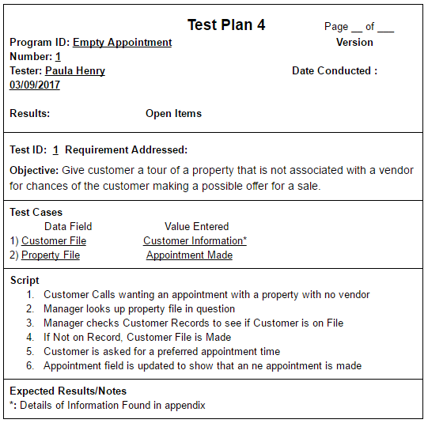
Empty appointment test plan

Slide 41
Property check overview
A monthly process that checks to find which properties are new, which properties haven’t been visited recently, properties that have had many appointments but no offers, and then creates lists for the parameters of the search. These lists are then reviewed by the manager and then the manager sends some to other processes while creating e-mails for vendors who own properties that have had many visit, yet no offers have been made. After the process is shut down the lists created by the processes are erased

Slide 42
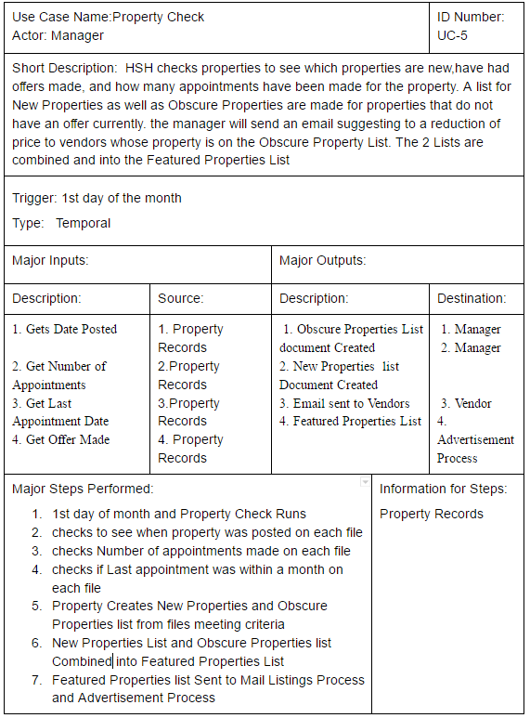
PROPERTY CHECK CASE

Slide 43
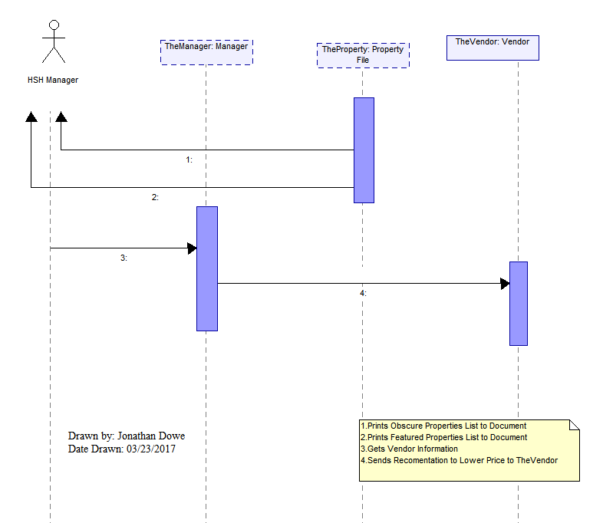
PROPERTY CHECK SEQUENCE DIAGRAM

Slide 44
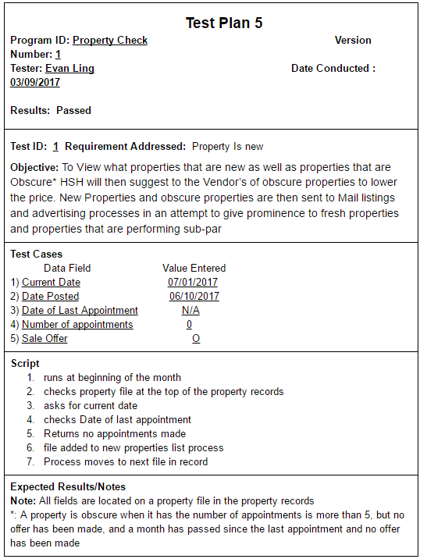
PROPERTY CHECK TEST plan 1

Slide 45
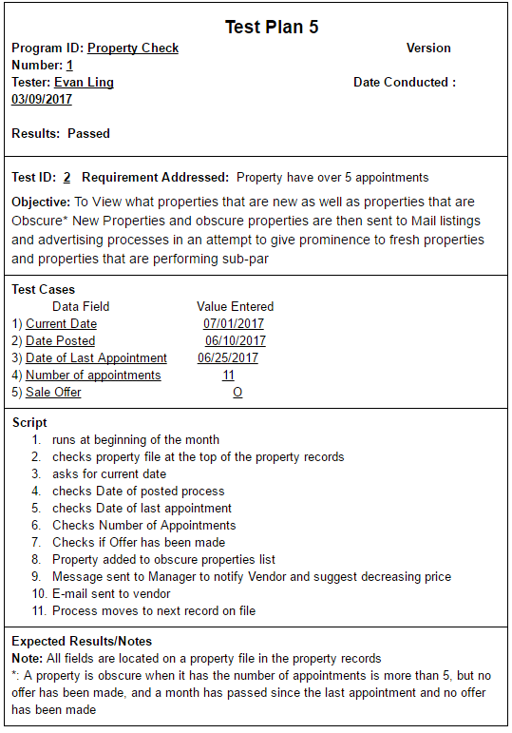
PROPERTY CHECK TEST plan 2

Slide 46
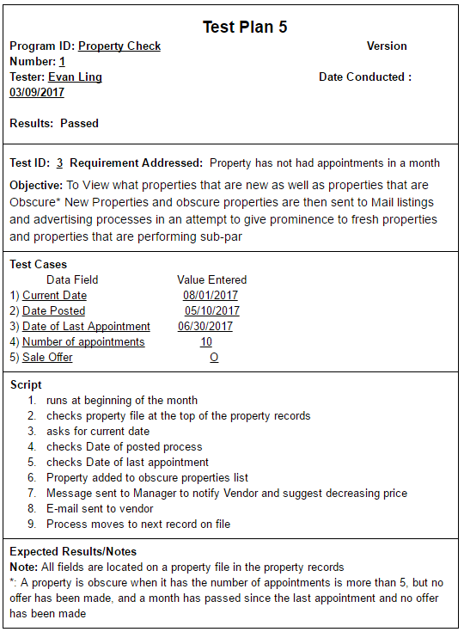
PROPERTY CHECK TEST plan 3

Slide 47
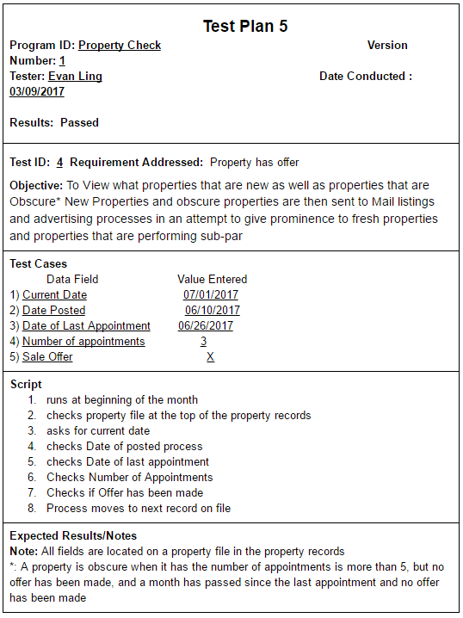
PROPERTY CHECK TEST plan 4

Slide 48
Advertisement overview
The manager uses a list created form the Property check list to create a neat word document that will be emailed to the local press for their ads section. This is don at the beginning at every month

Slide 49
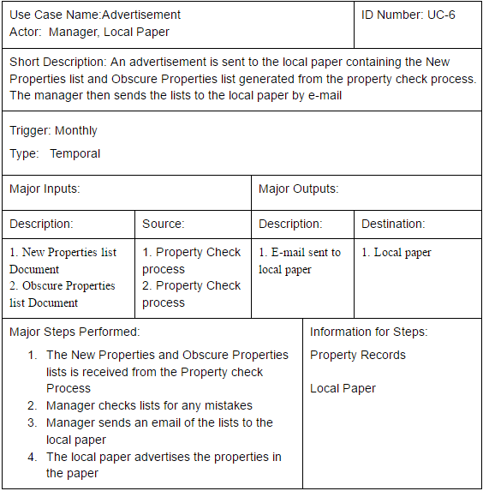
Advertisement Case

Slide 50
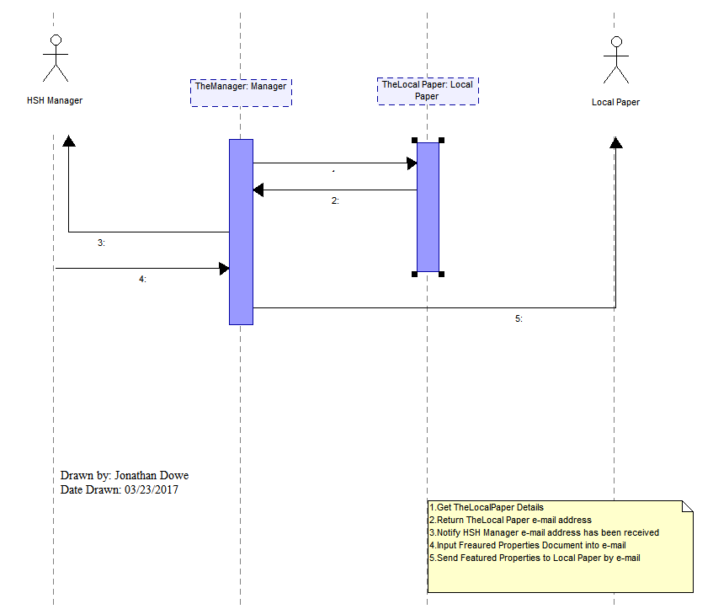
Advertisement Sequence Diagram

Slide 51
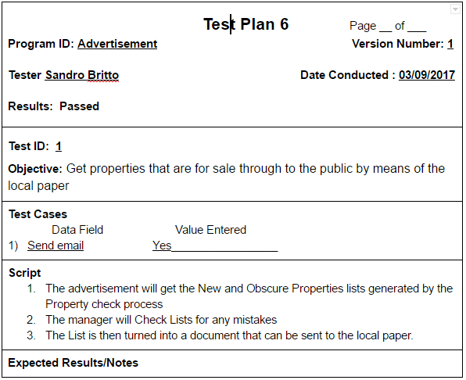
Advertisement Test Plan

Slide 52
Mailing list overview
Customer can get notifications about property that HSH deems to be of interest. The customer must contact HSH and ask to be put on their mailing list. The HSH representative will then ask for the Customers information to find the proper customer file to update.
At the beginning of every month The manager uses a list created form the Property check list to create a neat word document that will be emailed to the customers who have subscribed to the mailing list

Slide 53
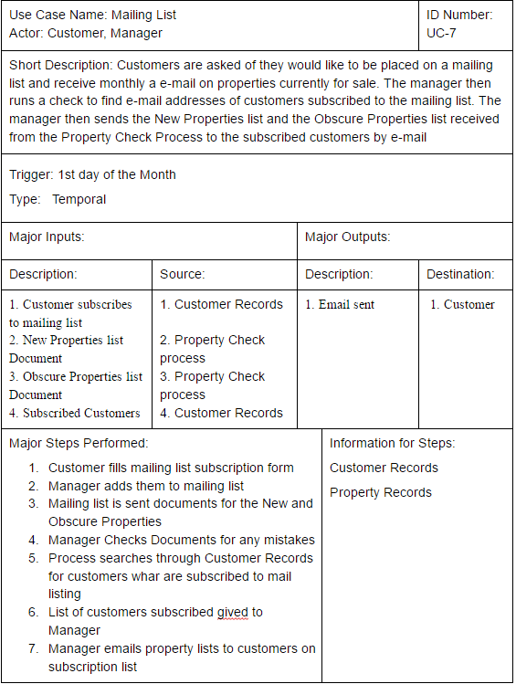
MAILING LIST CASE

Slide 54
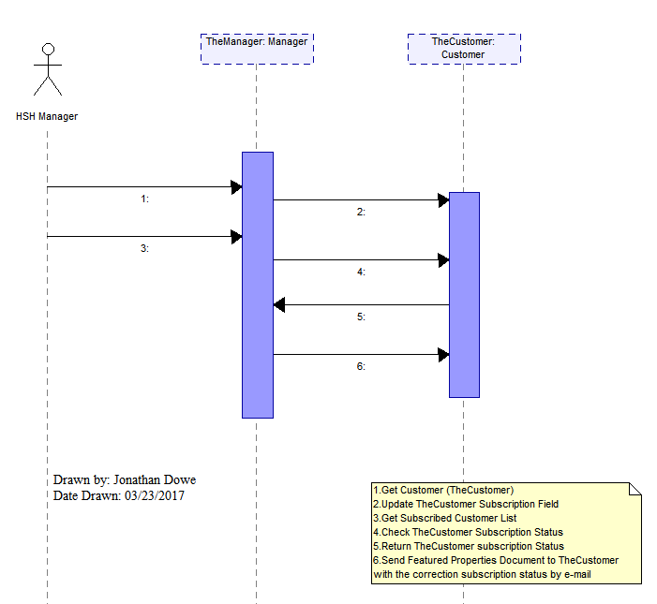
MAILING LIST SEQUENCE DIAGRAM

Slide 55
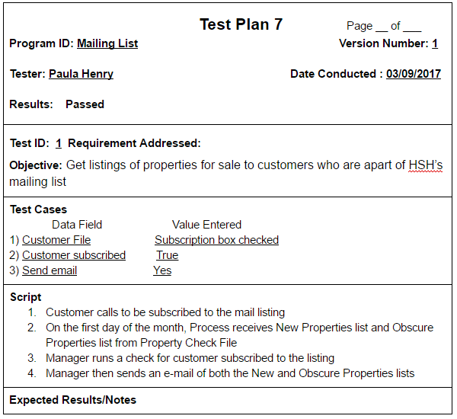
Mailing list test plan

Slide 56
Offer overview
A customer has decided to buy the property that HSH has listed. An HSH representative will then get the Customers information to find their file so tat the proper information can be sent to the vendor. The Property file in question is updated to reflect that it has an offer. The HSH representative will also notify Harry Sings Ltd so they can exchange the for sale sign for a sale pending sign

Slide 57
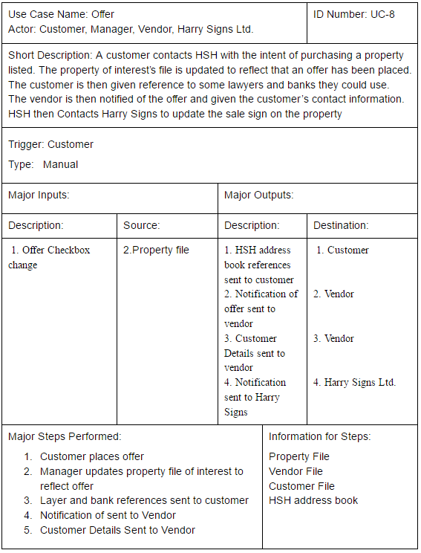
OFFER CASE

Slide 58
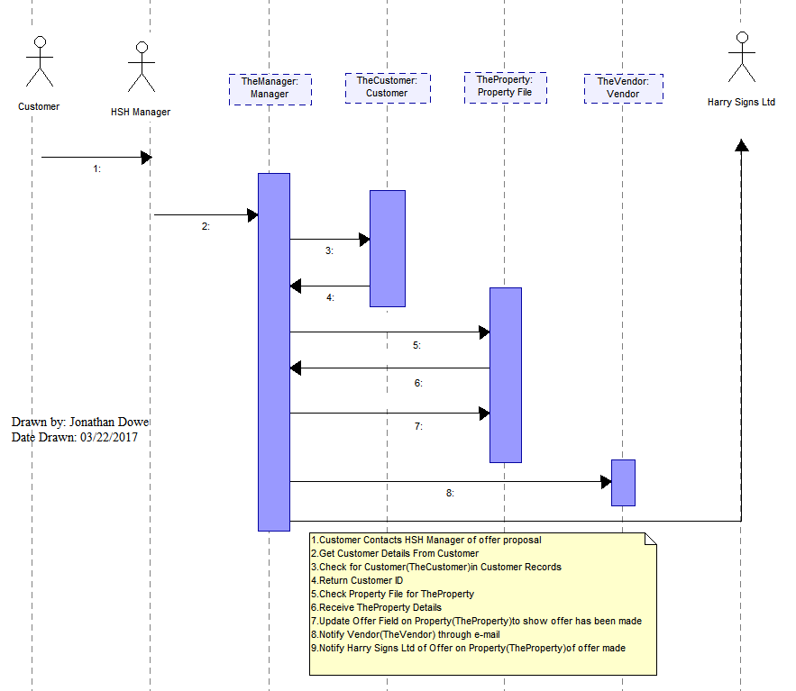
OFFER SEQUENCE DIAGRAM

Slide 59
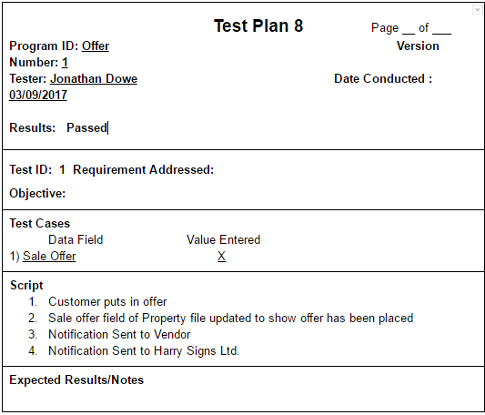
OFFER TEST plan

Slide 60
Offer withdraw overview
A customer who has an offer in may call saying that hey have decided not to go through with the offer and back out. HSH then contacts the Vendor to let them know. HSH will also update the property file’s offer field so that it will be listed as a current property. HSH will contact Harry Signs Ltd to exchange the sale pending sign for a for sale sign

Slide 61
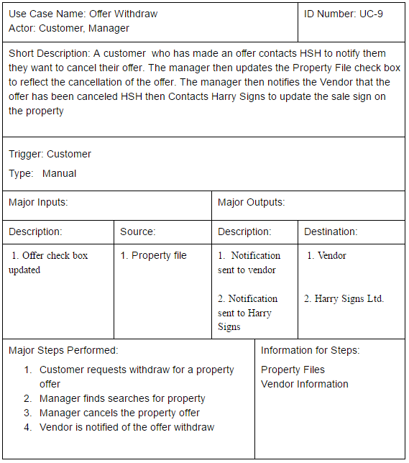
OFFER WITHDRAW CASE

Slide 62
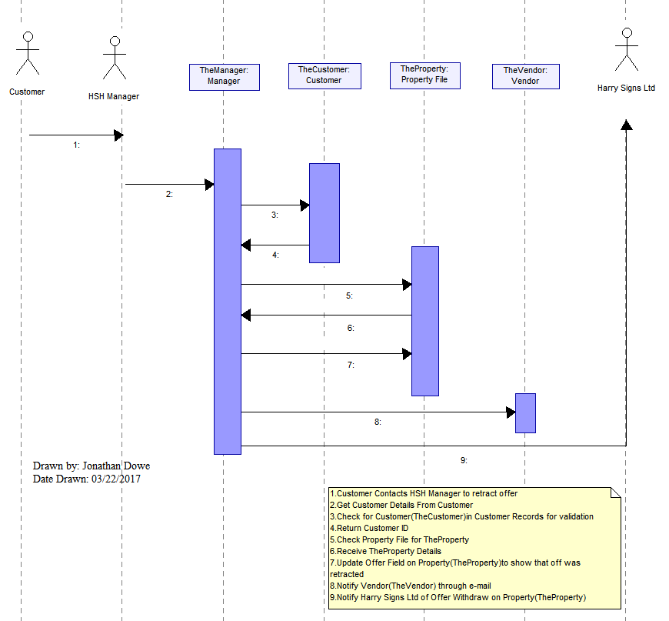
OFFER WITHDRAW SEQUENCE DIAGRAM

Slide 63
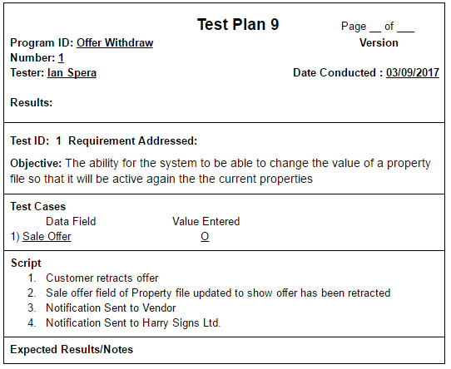
OFFER Withdraw TEST plan

Slide 64
Sold overview
A customer is ready to purchase the house and has gotten all legal matters out of the way. HSH receives the payment from the customer for the sale. HSH looks up the for the vendor who was selling the property for the bank check routing number. HSH then deducts their service fees from the payment and the rest of the payment is mailed to the vendor in a check. HSH Notifies Harry Signs that the Sale was made and they will update the sale pending sign to s Sold sign. HSH will then delete the property file from the Property Records

Slide 65
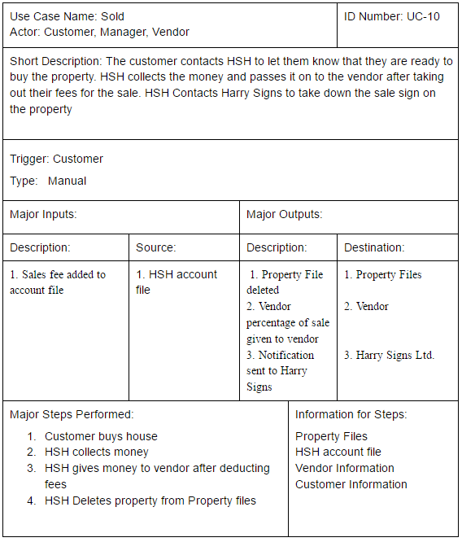
Sold case

Slide 66
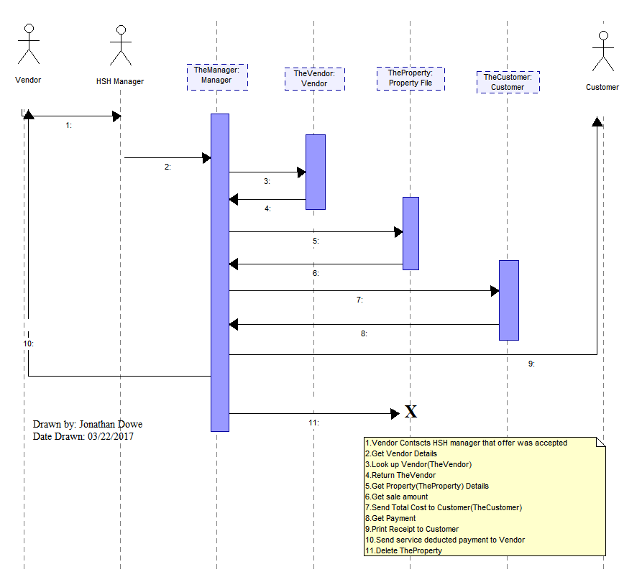
Sold sequence diagram

Slide 67
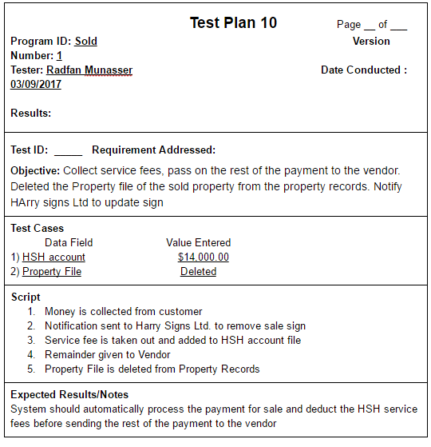
Sold test plan

Slide 68
Letting overview
Landlords will have HSH collect the Rent of their Tenants for them. HSH charges a small service fee for the collection. At the beginning of the month HSH will check the Tenant Records to see what they are charged for rent. HSH then collects the amount due from the tenants. HSH subtracts there service fee from the Payments made. HSH will then add their service fees to the HSH account file. HSH then looks up the landlords back check routing number in the landlord files to mail a check with the rest of the rent.

Slide 69
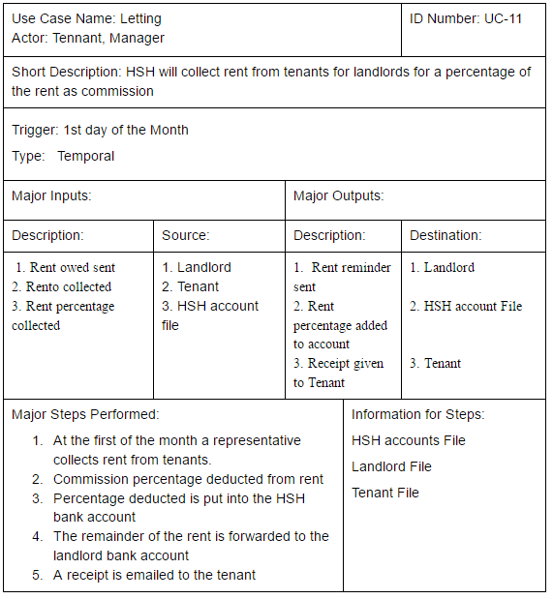
Letting case

Slide 70
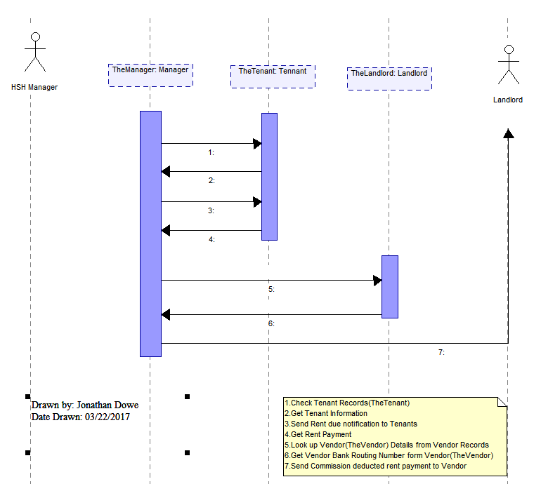
Letting sequence diagram

Slide 71
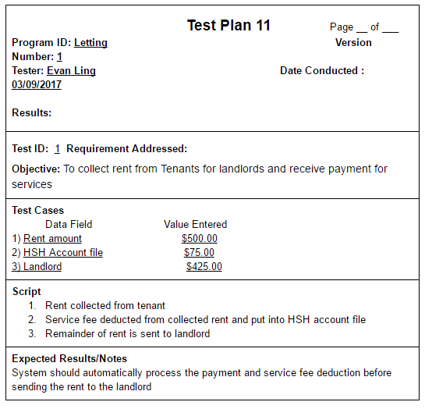
Letting test plan

Slide 72
Maintain property overview
Landlords who operate through HSH also have HSH take care of the Maintenance fee for the Rental Properties. The landlord does this to capitalize on the reduced prices HSH enjoys thanks to their line of work. The land lord is aware that they are charged more than the actual maintenance fee HSH accrues from the process, but it is still a deal to what they would normally pay HSH does this maintenance on a monthly basis using a contractor. The will notify the contractor at the beginning of the month that the maintenance cheeks needs to get done. The contractor will then send HSH a bill after the maintenance services are preformed of all the Rental Properties. HSH pays the contractor. HSH then charges the landlord a Commission fee greater than their bill to generate a profit

Slide 73
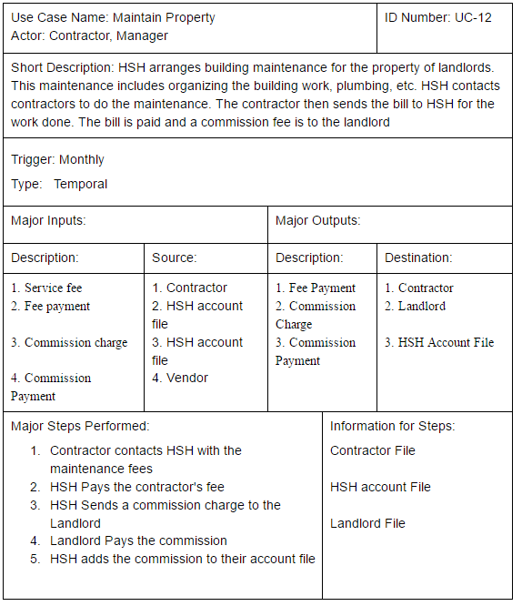
MAINTAIN PROPERTY CASE

Slide 74
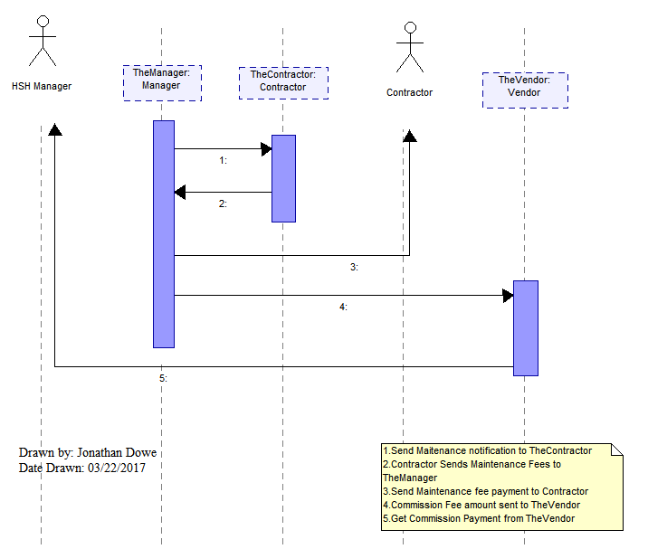
MAINTAIN PROPERTY SEQUENCE DIAGRAM

Slide 75
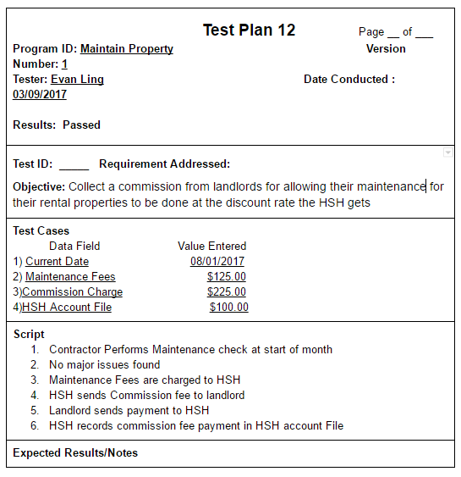
maintain PROPERTY TEST plan

Slide 76
Terminology
Home Sweet Home (HSH)
Real estate Agency we are working for
Information
Data about a Class that is useful to the processes of HSH
File
Information organized into a set of tables that is neat and easy to read
Records
A collection of Files that share the same Class type
Gather Property Details
The information gathered about the vendor and property when the vendor calls wanting to sell their property.

Slide 77
Terminology cont.
Property Information
Information gathered to by Gather Property Details put into the property file
Property address
Property size
Number of bedrooms
Number of Bathrooms
Building size (in square feet)
Photograph of the property
Vendor ID
Date Posted
Image of Property in either .jpg or .img format

Slide 78
Terminology cont.
Property File
Property Information
Offer Made
Input Type: Checkbox
Number of Appointments
Input type: Text Box
Constraints: Numeric
Last appointment Date
The last scheduled appointment of the Property

Slide 79
Terminology cont.
Property Records
The data store the contains all of the Property Files
Current Properties
A Property File that does not have a current offer placed
Property Records
Data store Containing Property Files
Relevant Summary Sheet(RSS)
The fact sheets that are displayed in the HSH high street office with a brief summary of the property along with a reduced photocopy for advertising purposes

Slide 80
Terminology cont.
New Property
A Current Property that is has been posted for less than 2 weeks
Obscure Properties
Current Properties that has had less than 4 appointments within a month of either the date posted or the Last Appointment Date

Slide 81
Terminology cont.
Obscure Properties List
A List generated by the property check process that will be used within the process as well as in the Advertisement and Mailing List processes
New Properties List
A second list generated by the Property Check Process to be used by the Advertising and Mailing List Processes
Featured Properties list
A list created from combining the Obscure and New Properties lists

Slide 82
Terminology cont.
Empty Property
A Property that does not have a vendor
Harry Signs Ltd.(HSL)
External entity that gathers vendor Information and puts up the for sale sign on the property for HSH

Slide 83
Terminology cont.
Vendor(seller)
Person who invites HSH to sell their property
Vendor Information
Vendor ID
Vendor Name
Vendor Address
Vendor Phone Number
Vendor e-mail
Vendor bank account routing number
Vendor Availability
-availability for potential buyers(customers

Slide 84
Terminology cont.
Vendor File
Vendor Information
Memo field
-a field on the Vendor Database that allows staff to Store useful comments
Vendor Records
The data store the contains all of the Vendor Files

Slide 85
Terminology cont.
Customer(Buyer)
A person who contacts HSH to make an appointment or offer on a Current Property
Customer Detail
Customer Name
Customer email
Customer Phone Number
Customer Information
Customer ID
Customer Details
Customer address
Customer Records
The data store the contains all of the Customer Files

Slide 86
Terminology cont.
Tenant
People who are renting property, but do not own
Tenant Information
Tenant Name
Tenant Address
Tenant e-mail
Tenant File
Tenant Information
Tenant Records
The data store the contains all of the Tenant Files

Slide 87
Terminology cont.
Landlord
Person who rents properties to Tenants
Landlord Information
Landlord Name
Landlord address
Landlord Phone Number
Landlord e-mail address
Landlord bank account check routing number
Landlord File
Landlord information
Landlord Records
The data store the contains all of Landlord Files

Slide 88
Terminology cont.
Contractor information
Contractor Name
Contractor address
Contractor e-mail
Contractor Phone Number

